Slide 1
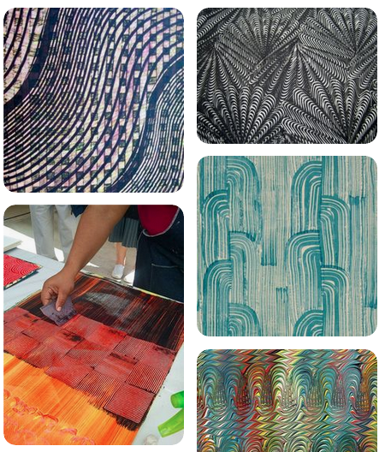
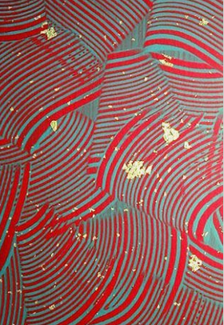
Paste Paper Collage!

Slide 2
Eric Carle-
The Artist Who Painted a Blue Horse

Slide 3
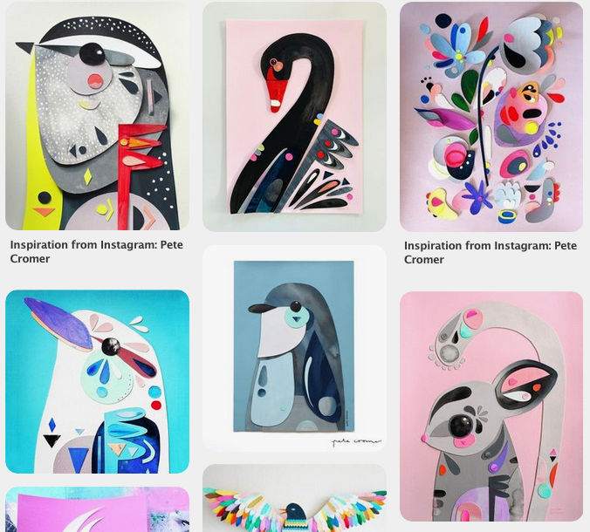
Pete Cromer

Slide 4
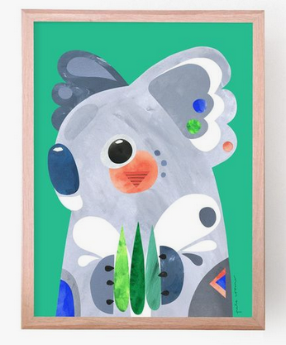
Pete Cromer

Slide 5
Mix colors with partner
Play with paste paper to make patterns!

Slide 6
https://www.youtube.com/watch?v=wGo-QkHTbUY
https://www.pinterest.com/pin/495325659010915431/ https://www.pinterest.com/pin/64528207146740242/?lp=true
REFERENCES

