Slide 1
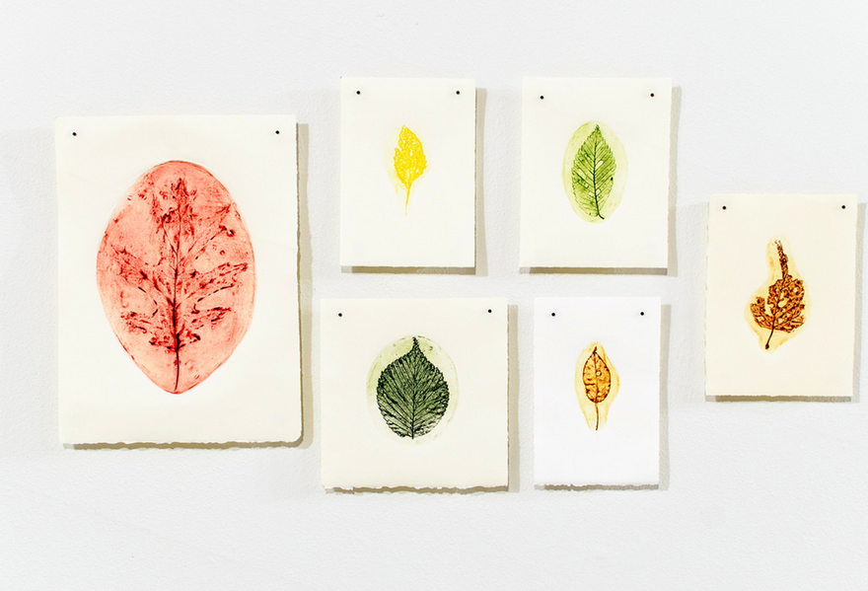
Printmaking from Nature with Vegetables and Leaves!
Alexis Dwyer

Slide 2
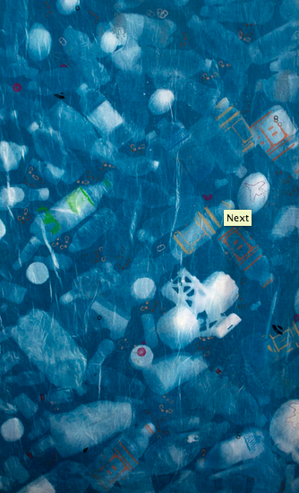
Alexis Dwyer
Treasure Map, Cyanotype, Relief Printmaking, 63”x44”, 2017

Slide 3
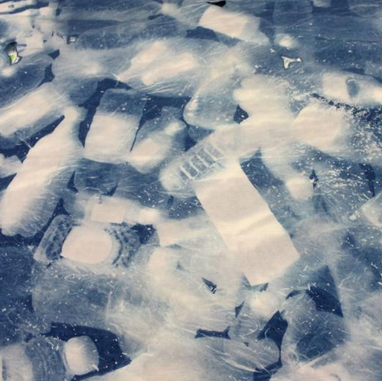
Alexis Dwyer
Made from trash!

Slide 4
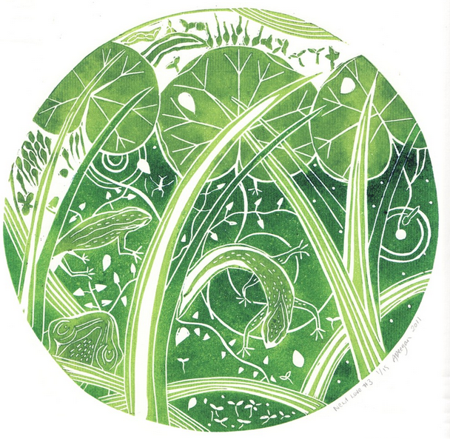
Allison Deegan
Newt Love
Lithograph

Slide 5
References
https://www.voxmagazine.com/arts/the-art-of-printmaking-alexis-dwyer-finds-inspiration-in-nature/article_d6d0d312-b673-11e7-a659-b776157dbe93.html
http://www.alexisdwyerstudio.com/on-the-beaten-path.html
https://www.jacksonsart.com/blog/2015/05/01/impressions-of-nature-printmaking-competition-winners/

